Slide 1
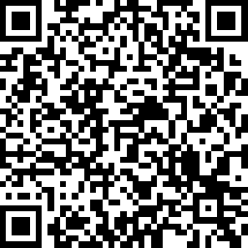
MD/MPH Info Session

Slide 2
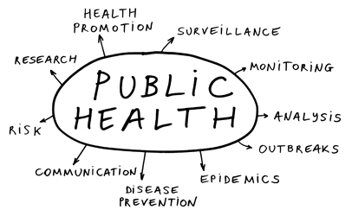

Slide 3
Public Health goes beyond healthcare…
Notes:
Education, safe environments, housing, transportation, economic development, access to healthy foods — these are the major social determinants of health, comprising the conditions in which people are born, live, work, and age

Slide 4
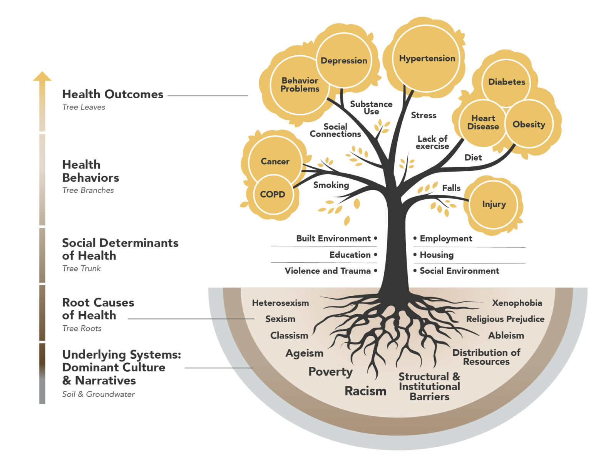
Pioneer Valley Planning Commission
Notes:
Education, safe environments, housing, transportation, economic development, access to healthy foods — these are the major social determinants of health, comprising the conditions in which people are born, live, work, and age

Slide 5
Where do you fit in as a clinician?

Slide 6
Why do an MD/MPH at Penn?
Notes:
Continuity
Flexibility/choice in program (choose your own electives, FW, capstone)

Slide 7
Why Penn?
Interprofessional Education
MPH
MSW/MPH
MD/MPH
DMD/MPH
MSN/MPH
MBE/MPH
JD/MPH
PhD/MPH
VMD/MPH
MS/MPH
MPA/MPH
MSSP/MPH
ML/MPH
MES/MPH

Slide 8
MD/MPH Students + Residency

Slide 9
MD/MPH Program at Penn
REQUIRED COURSES:
6 CU of required core course units
2 CU of capstone seminar
6 CU of electives
BUT, we transfer in at least* two credits from MD
curriculum
In the end… TOTAL of 12 CU [max]
Also need 125 hours of (non-clinical) fieldwork!

Slide 10
What does this look like?
MS1 fall: Could take 1 MPH course (1 of 3 “frees” – Additional Course Policy)
MS1 spring: Could take 1 MPH course (1 of 3 frees)
Summer 1: Could to an immersion experience or a course (1 of 3 frees)
MS2 fall: Could take 1 MPH course (1 of 3 frees)
MS2 spring → MS3 spring: Clerkships
MS3 spring: Official MPH application/matriculation
MS4: Year out for full-time MPH courses and research
MS5: ½ year to complete MD work & apply for residency (fall)
½ year to complete MPH (spring)

Slide 11
Fieldwork Projects
Serving as a near-peer mentor for Teens Make Health Happen program through HealthCorps to identify a pressing health issue impacting their school and design an intervention.
Working with the Climate Committee of the Group for the Advancement of Psychiatry to study child anxiety about climate change (ultimately writing a children’s book).
Providing community resources and assessing the Family Connects Program at CHOP.
Supporting the Mental Health Unit of the District Attorney's Office (DAO)
Conducted a health needs and assets assessment in the community of San Cristóbal, Galápagos, through the Galápagos Education and Research Alliance (GERA).

Slide 12
Capstone Projects
Investigating perspectives and emotions on climate change among children and adolescents in San Cristóbal, Galápagos
Visual representation of early-stage Lyme disease across skin tones in medical resources: Are we hitting the target?
“To a reasonable degree of medical certainty”: Use of medico-legal authority in involuntary civil commitment
Evaluating the sustainment of a community health worker-delivered intervention integrating asthma care in West Philadelphia schools
Assessing the Landscape of Rehabilitation Services in Botswana
The Historic Relationship between Brownfields and Public Housing Sites in Philadelphia from 1928-2010
Driver licensure and motor vehicle crash rates among adolescents with mood disorders

Slide 13
How to pay for your MD-MPH?
Scholarship funds are available from the MPH Program
Penn MPH program is “per CU” (not “flat rate”)
MPH program offers scholarships up to 9 CU – i.e. 75% of tuition! **does not include fees
Can you get the other 3 CU covered?
Could use three “frees” from med school tuition years under the PSOM Additional Course Policy
Single application for program & scholarship
Application due during winter of MS3

Slide 14
Which one to choose?
Dual
Degree
Certificate in PH Medicine

Slide 15
Certificate in Public Health Medicine
Public health immersion experience
Two formal courses in public health at Penn
Scholarly pursuit project must be public health focused
Dr. Mario DeMarco (Mario.DeMarco@pennmedicine.upenn.edu)

Slide 16
How to get started with courses?
This fall PUBH prefix course is popular with medical students:
PUBH 5190 – Issues in Global Health**
Taught by Carol McLaughlin, MD MPH
Tuesdays 5:15 – 8:15 pm
Other available Fall courses include:
PUBH 5040 (Theories and Frameworks) – Tuesday 5:15 pm
PUBH 5050 (Policy and Administration) – Thursday 5:15 pm
PUBH 5250 (Health & Human Rights) – Monday 5:15 pm
Course Registration Form: https://hosting.med.upenn.edu/forms/mdprogram/view.php?id=30974
Hillary Nelson, PhD MPH
hnelson@pennmedicine.upenn.edu
Moriah Hall, MPH
moriahh@pennmedicine.upenn.edu
Reach out to us in November about spring courses!

Slide 17
Reach out to a Current Student
MD/MPH Students (MS5):
Joey DelFarro | Joseph.DelFarro@pennmedicine.upenn.edu
Michaela Hitchner | Michaela.Hitchner@pennmedicine.upenn.edu
Andrea Jin | Andrea.Jin@pennmedicine.upenn.edu
Victoria Lord | Victoria.Lord@pennmedicine.upenn.edu
Jarvis Mays Ben Semeao | Jarvis.Mays@pennmedicine.upenn.edu Benjamin.Semeao@pennmedicine.upenn.edu

Slide 18
Core Functions
Integrating Science and Action
Educating the Public Health Workforce
Leading Public Health Initiatives
Elevating Programs in Our Community
**FREE Seminar Series!

Slide 19
Contact us!
Hillary Nelson, PhD MPH
Director, MPH Program Co-Chair, MD-MPH Advisory Committee
hnelson@pennmedicine.upenn.edu
(215) 746-8554
Moriah Hall, MPH
Associate Director, MPH Program
moriahh@pennmedicine.upenn.edu
(215) 573-8841
Francia Portacio, MPH
Associate Director
Combined Degree Programs
Francia.portacio@pennmedicine.upenn.edu
Michael Sabara, MEd
Director, Financial Services
msabara@pennmedicine.upenn.edu
(215) 573-3423
MPH website
MD/MPH website

