Slide 1

  Caring for Students During Their Academic Journey
Notes:
Let's begin with Student Health and Counseling
This organization brings together clinicians to cater to your (our students’) physical and emotional needs
as they navigate their academic journey at Penn

Slide 2

A Moment of Reflection
Think back to what the last year has felt like for you.
What has felt challenging?
What ways have you been resilient?
Notes:
Interactive: 3-4 people

Slide 3
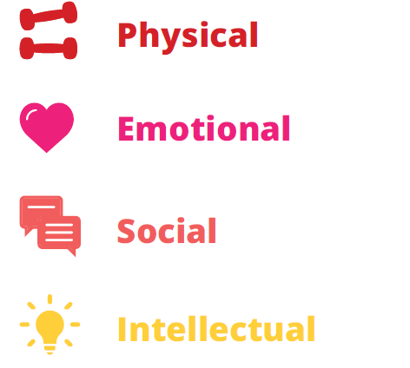

Support Wellness
with the 3 P’s
Be Proactive
Connect With Other People
Seek Professional Support
Notes:
So what are some ways you can stay mentally AND physically healthy – and remain focused on all 8 domains of wellness?
1. Be Proactive-Develop your coping toolkit-What helps you manage stress? What does self-care look like to you? Self-care can look different for all of us.
2. Connect with other people-Talk to people you trust; Social support is protective for our mental and physical health.
3. Seek Professional Support-Reach out to Student Health and Counseling if you need support. Seeking help is a sign a strength.
Use the 8 domains to check-in with yourself in each area.

Slide 4
Be Proactive
Notes:
Don’t wait until you’re burned out or going through an emotional crisis to implement self-care strategies. Stress is going to happen and that’s normal and typical. How we manage the stress and our mood if something we can choose to proactively manage.

Slide 5
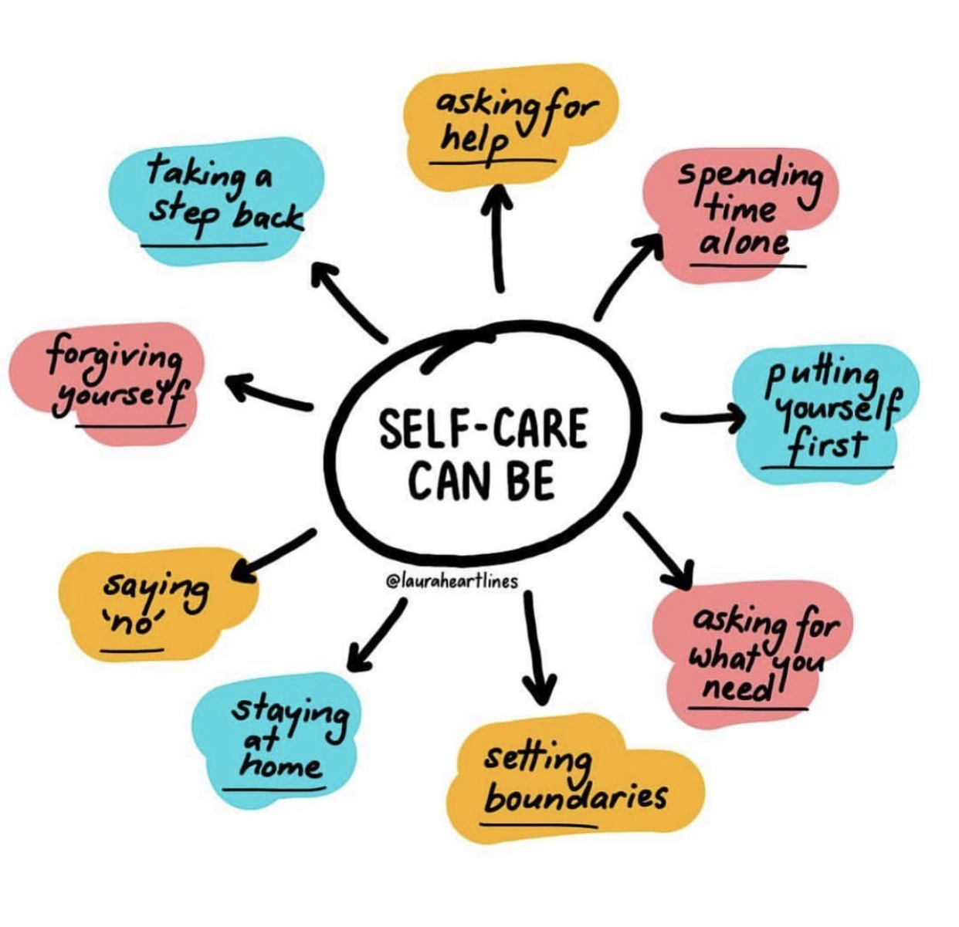
Self-Care Myths
Self-care is selfish.
Self-care is one more thing I have to do.
There is a “right” way to do self-care.
Notes:
Self-care can go beyond the “manicure, skin care, sleep, etc). It can be something like making sure you eat when you’re hungry or engaging in enjoyable activities.

Slide 6
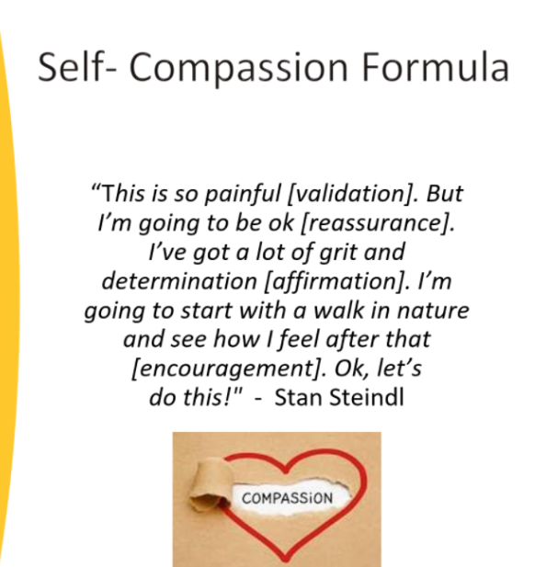
Self Compassion
1 sentence of Validation
1 sentence of Reassurance
1 Affirmation
1 way to Cope
1 sentence of Encouragement
Notes:
One of the most frequent self-care strategies that I discuss and practice with my students is the importance of self-compassion.

Slide 7
Connect with Other People
Notes:
Sometimes we can lost in our own minds and a common “warning sign” of stress becoming distress is increased isolation.

Slide 8

Social Support
Support from friends can buffer the negative effects of stress
Quality vs. Quantity
Notes:
We are relational beings! We need other people.

Slide 9
Seek Professional Support

Slide 10


Counseling services
Student Health & Counseling
24/7 access and support
Drop-in services (Let’s Talk and on-site)
Individual therapy
Group therapy
Psychiatric medication
Referral and consultation services
All counseling services offered at Penn are covered by your student fees.
Notes:
We offer solution-oriented, short-term care that is tailored to fit each student’s unique needs
Our services are free and confidential
Mental health services are offered in-person and may be also be offered virtually in some circumstances
You can access services by calling our main number (24/7). If you would like to talk to someone right away, press #1. If you want to make an appointment, press 2. You can also come in and meet with someone during regular business hours. Nothing is too big or too small. -Please remember, we are always available for urgent needs.
Please continue to check out website for updates on hours and policies.

Slide 11
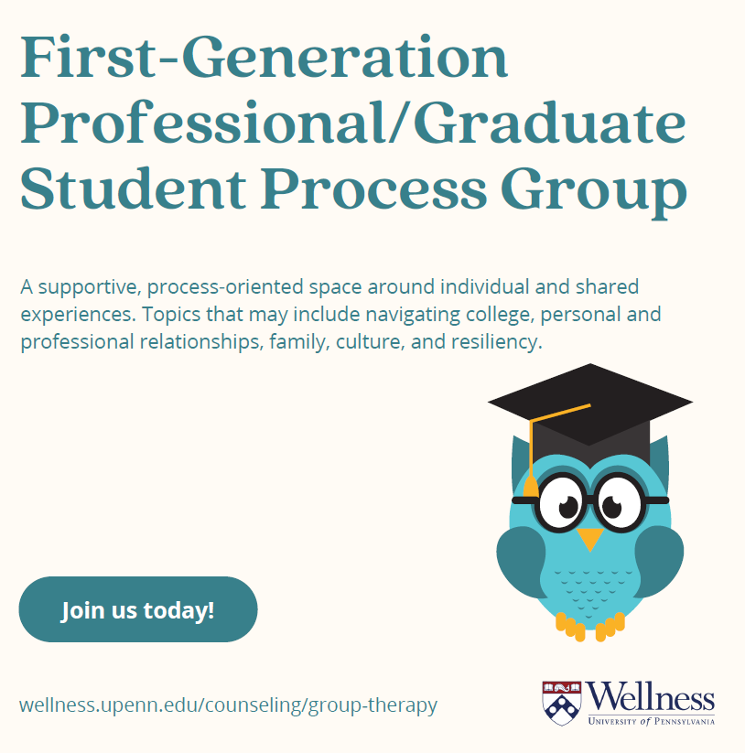
A Note About Group Therapy: An Example
Refer to the website listed at the bottom
*You can always email me directly for more information about upcoming Group Offerings
Notes:
This was a group offering from last Spring 2024 semester. Additional groups that were offered last year included: international student empowerment group, grief support group, survivors of sexual assault group, empowerment in relationships group, mandarin community support group, gender expansive drop-in support group, mindfulness workshops and more!

Slide 12

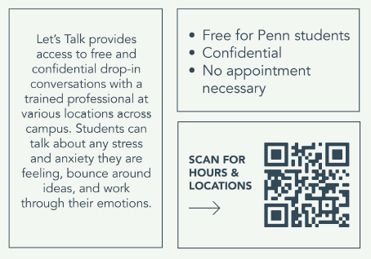
Counseling
Student Health & Counseling

Slide 13
Student Health & Counseling
Embedded Counseling Services
In addition to the services and providers available at 3624 Market, BGS has its own embedded therapist!
Embedded therapist, Chelsea Minsky, LPC provides:
Individual counseling
One-time consultations and brief support
Referrals to other resources on and off campus
In-person and Zoom sessions
Hours: Monday-Friday 9:00-5:00
To schedule:
Email Chelsea Minsky: cminsky@upenn.edu
Call 215-898-7021 option 2 to reach the Counseling Center front desk and ask to schedule with Chelsea Minsky as a BGS student

Slide 14



It’s okay to not be okay.
Wellness is not linear.
We are here to support you.
It’s okay to struggle.
You can cycle back for support.
Taking care of yourself is a process.
Notes:
-Wellness is here to support you, no matter where you are in your wellness journey

Slide 15



Follow us: @WellnessAtPenn @PennTogether
Student Health and Counseling:
-- Medical services: 215-746-3535 (3535 Market Street, 1st Floor)
-- Counseling services: 215-898-7021 (3624 Market Street, 1st Floor West)
Visit our Website: https://wellness.upenn.edu
Stay Connected!
Public Health and Wellbeing:
-- Immunization and Insurance Compliance: 215-746-4200
-- Public Health: 215-898-0300
Notes:
Take a picture of this slide so you have all of these helpful numbers and resources

Slide 16
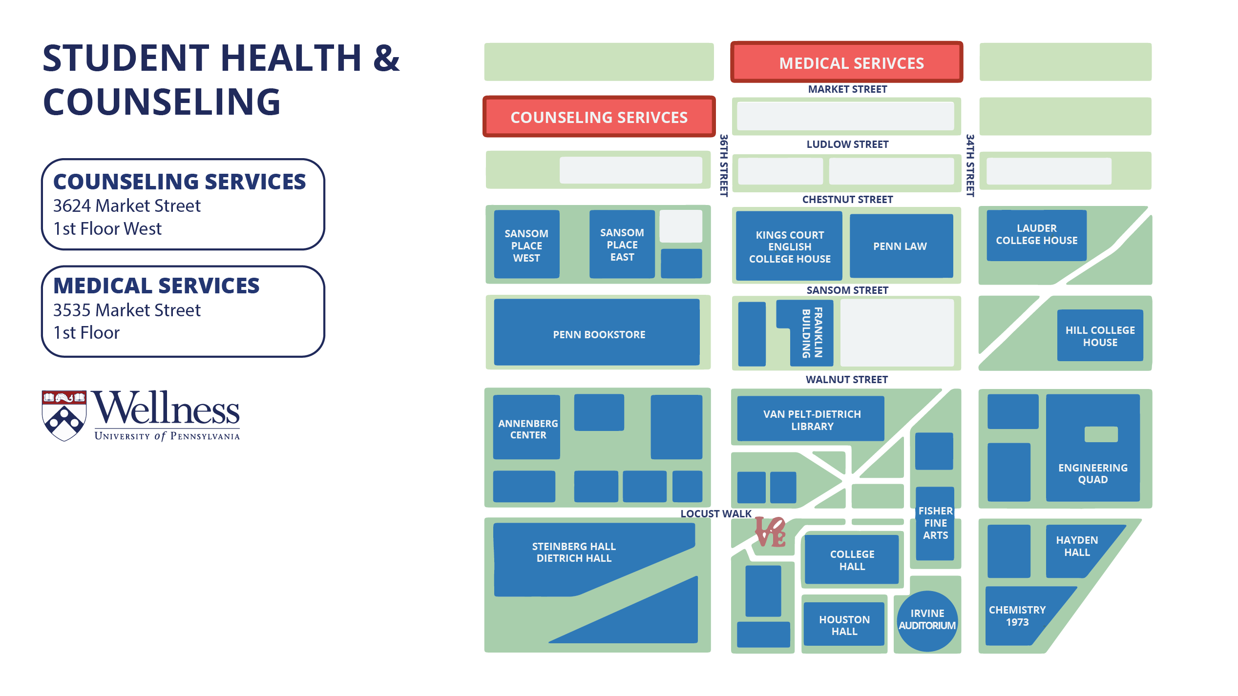
Visit us!
Notes:
Public Heath and Wellbeing, as well as Immunization and Insurance Compliance are both also in 3535, but on the Mezzanine level.

Slide 17
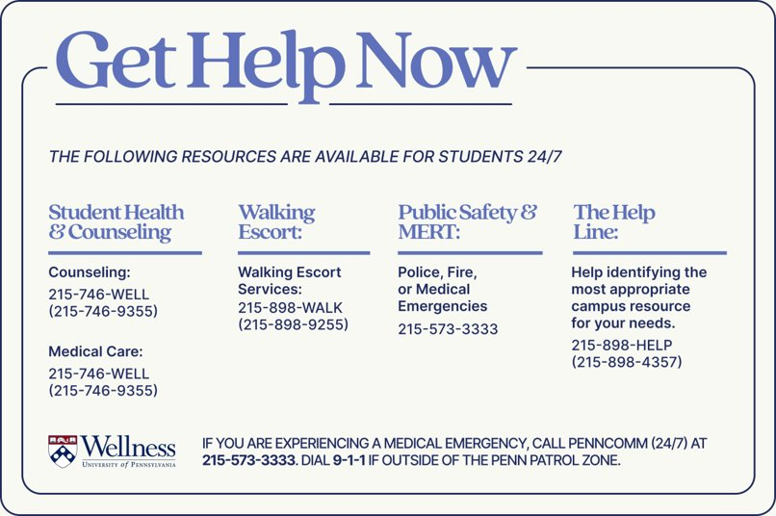
Notes:
- Here is a list of 24/7 resources available for students who are in need of support.
- We strongly recommend you take a picture of this slide and add these numbers to your phone.

Slide 18

Connect with your Embedded Staff
Email Chelsea Minsky, LPC @ Cminsky@upenn.edu
Notes:
Thank you! Thank you, Judy!

