Slide 1
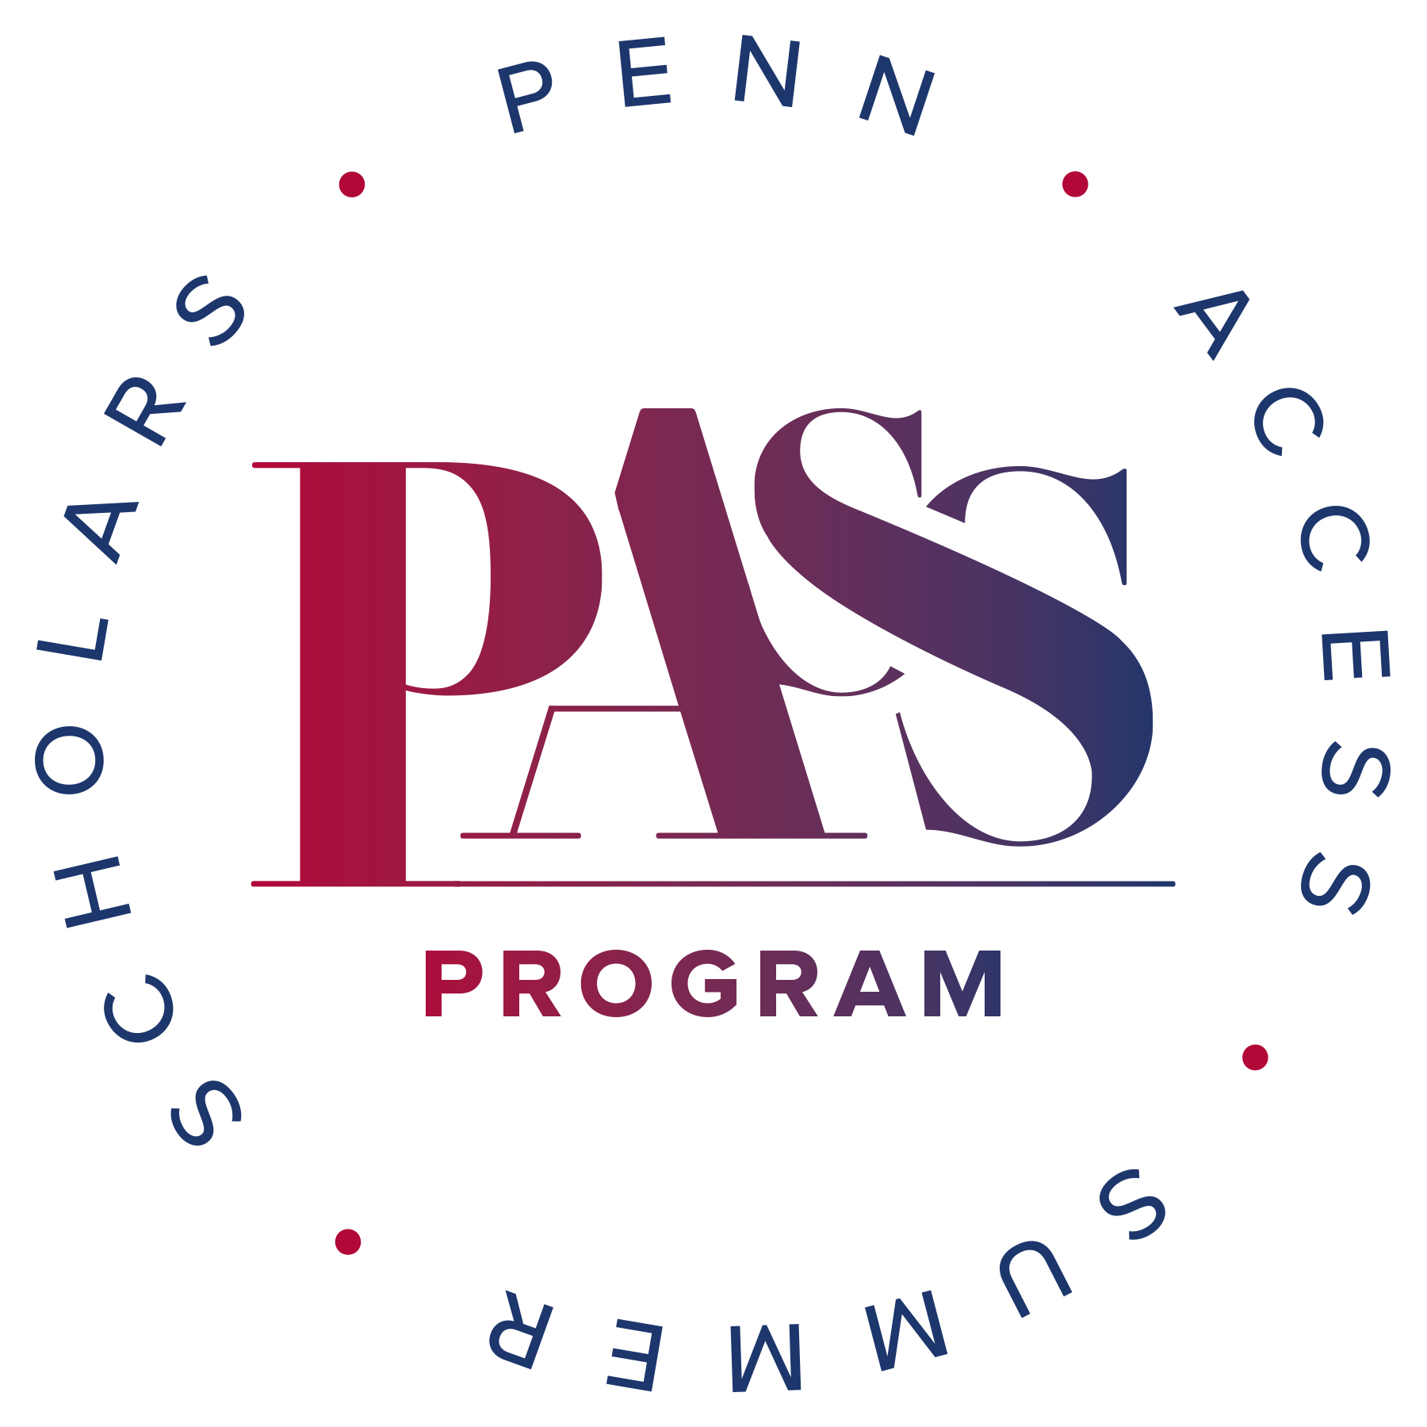

Community Engagement Through Pathway Programs
Horace DeLisser, MD
Associate Dean for Diversity and Inclusion
Perelman School of Medicine
University of Pennsylvania

Slide 2
Objectives
1. Defining the imperative of diversity
2. Describe the Penn Access Summer Scholars (PASS) program
3. Grand vision for pathway programs
4. Questions, comments, discussion
https://www.med.upenn.edu/idealmed/

Slide 3
Imperative for Diversity in Healthcare
1. Diversity empowers the enterprise of medical education
2. Diversity in the healthcare workforce and administration foster trust in the healthcare system
2. Diversity in the healthcare workforce enhances the quality of healthcare provided and (likely) mitigates health disparities
https://www.med.upenn.edu/idealmed/

Slide 4
Imperative for Diversity in Biomedical Science
1. Science thrives when there is diversity of thinking
2. Diversified scientific voices are needed to foster trust, to effectively educate the public and to speak to the policy implications of science
3. Enables the opportunity to experience the “rush” of creating new knowledge
4. Diversity in science undermines constraining and negative societal stereotypes
https://www.med.upenn.edu/idealmed/

Slide 5
Imperative for Diversity in Healthcare
Applicants and Matriculants to U.S. MD-Granting Medical Schools by Race/Ethnicity 2023-2024
Race/Ethnicity | Applicants (%) | Matriculants (%)
American Indian or Alaska Native | 90 (< 1) | 36 (<1)
Asian | 12,600 (24) | 5901 (26)
Black or African American | 4672 (9) | 1845 (8)
Hispanic, Latino, or of Spanish Origin | 3177 (6) | 1493 (6)
Native Hawaiian or Other Pacific Islander | 57 (< 1) | 19 (< 1)
White | 21131 (40) | 9534 (41)
Other | 10850 (21) | 4153 (18)
Total | 52,577 | 22,981
660 Black males and 714 Hispanic/Latino males matriculated
https://www.aamc.org/data-reports/students-residents/data/2023-facts-applicants-and-matriculants-data
https://www.med.upenn.edu/idealmed/

Slide 6
Diversity in Medical Education
A richness of student experience that empowers the enterprise of medical education
https://www.med.upenn.edu/idealmed/

Slide 7
https://www.med.upenn.edu/idealmed/

Slide 8
Overview of PASS
1. Linkage admission program to PSOM for undergraduate students from groups underrepresented/underserved in medicine attending one of 10 partnering institutions
Non-HBCUs (4): Bryn Mawr College, Haverford College, University of Pennsylvania, Princeton University
HBCUs (5): Howard University, Morehouse College, Oakwood University, Spelman College, Xavier University of Louisiana
Research Enrichment Program : STEMMPrep
1 or 2 selected each year from each institution
Students who complete the program are eligible to apply for admission to PSOM without the MCAT
https://www.med.upenn.edu/idealmed/

Slide 9
Overview of PASS
2. Rigorous selection criteria
Each partnering institution identifies in the spring, using holistic review, 3-5 sophomores who are academically strong (SAT >1300; GPA ≥ 3.6), from groups underrepresented in medicine or from groups underserved in medicine, with compelling personal qualities and evidence of leadership, initiative and impact
Identified students are interviewed by the deans and staff of IDEAL Med at PSOM
Executive Committee on Admissions the makes final selections, based on the above and a student’s fit for and likelihood of success at PSOM
3. Consists of two consecutive summers (after sophomore and junior years) of mentored research and enrichment experiences on Penn’s Campus
https://www.med.upenn.edu/idealmed/

Slide 10
Goals of the PASS Summer Program
1. Create a sense of community and cohesion among the cohort of PASS students
2. Foster the mentor/mentee relationship between the PASS student and their supervising research faculty
3. Promote the development of a physician identity and professionalism in the PASS students
4. Expose PASS students to high quality biomedical research as well as develop pertinent research skills
5. Facilitate the students transition into Perelman
https://www.med.upenn.edu/idealmed/

Slide 11
Components of the PASS Summer Program
1. An In-Person Research Experience
2. A Program of Enrichment
3. Near-Peer Mentoring
4. Individualized advising and coaching
https://www.med.upenn.edu/idealmed/

Slide 12
Research Component of the PASS Summer Program
1. Mentored Research
2. Online Research-related Modules (1st Summer Students)
Responsible conduct of research
How to read a research article
How to create a journal club presentation
How to design a research poster
How to communicate professionally
https://www.med.upenn.edu/idealmed/

Slide 13
Research Component of the PASS Summer Program
3. Research Presentations
“Mentor and their research” (week 2)
Journal club presentation (weeks 5 & 6)
Research presentation (week 8)
4. Weekly 1-on-1 meetings with research mentor
5. Participation in lab/research related meetings, journal clubs and conferences as possible
https://www.med.upenn.edu/idealmed/

Slide 14
Enrichment Component of the PASS Summer Program
1. Podcast Discussions
2. Physician Career Narratives
3. Virtual Clinical Encounters
4. Didactics
5. Book Club Discussions
6. Arts & Humanities
7. Clinical Shadowing
https://www.med.upenn.edu/idealmed/

Slide 15
Near-Peer Mentoring of the PASS Summer Program
1. Provide emotional support to PASS students
2. Provide logistical and administrative support
3. Supervise weekly reflection and team-building activities
4. Facilitate Podcast discussion
5. Organize ”Fun & games” activities
https://www.med.upenn.edu/idealmed/

Slide 16
Advising Component of the PASS Summer Program
Each student has a 1-on-1 meeting with
The faculty director
The program director
A medical student mentor
2. Conducted on weeks 3, 5 and 7
https://www.med.upenn.edu/idealmed/

Slide 17
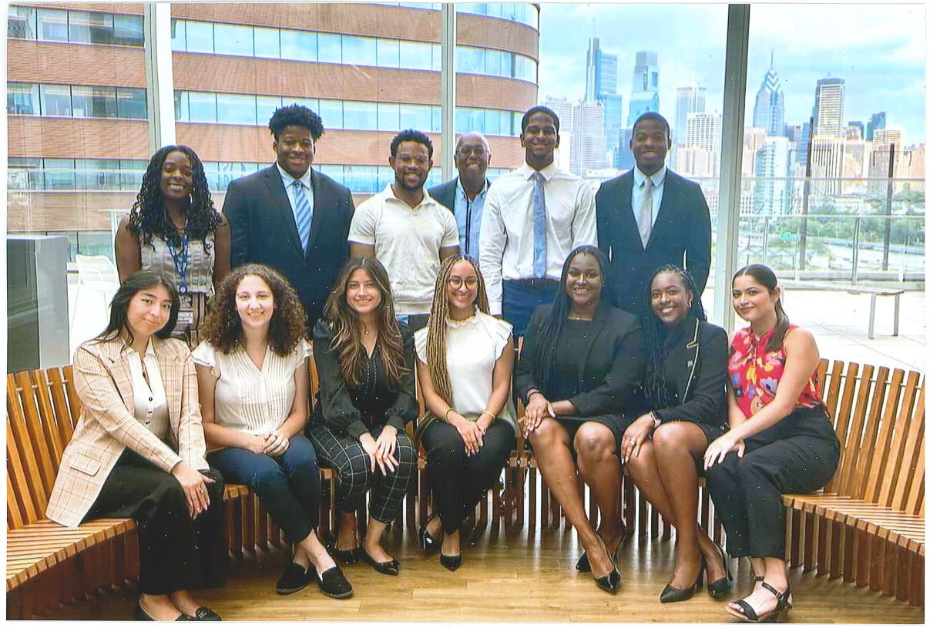
Penn Access Summer Scholars Program
Total Participants – 96
Perelman Matriculants – 60
Expected 2024 Matriculants – 12
Expected 2025 Matriculants – 12
Perelman Graduates – 23
Second Summer 2023 Cohort
https://www.med.upenn.edu/idealmed/

Slide 18

The Grand Vision for Pathway Programs at Perelman

Slide 19
Perelman School of Medicine High School and College Undergraduate Pathway Programs
Undergraduate Pipeline Programs
PASS-Non-HBCU
High School Pipeline Programs
Bryn Mawr, Haverford, Penn Princeton
Educational Pipeline Program
Summer Mentorship Program
PASS-HBCU
Xavier, Oakwood, Spelman Morehouse, Howard
PhysicianTrack Program*
Hinkson Holloway Mentoring Program*
Johnson Scholars
Penn
* Under development
PASS - Penn Access Summer Scholars
https://www.med.upenn.edu/idealmed/

Slide 20

Perelman School of Medicine High School and College Undergraduate Pathway Programs
The Grand Vision
High School Pipeline Programs
Partnering
Schools
Undergraduate Pipeline Programs
Educational Pipeline Program
Bryn Mawr, Haverford Penn, Princeton
PASS-Non-HBCU
Summer Mentorship Program
Xavier, Oakwood, Spelman Morehouse, Howard
PASS-HBCU
PhysicianTrack Program*
Hinkson Holloway Mentoring Program*
Penn
Johnson
Scholars
* Under development
https://www.med.upenn.edu/idealmed/

Slide 21

Discussion Comments Questions

