Slide 1

Planning for your future
Traversing the bridge years
Skip Brass
University of Pennsylvania
Medical Scientist Training Program
February 4, 2009

Slide 2
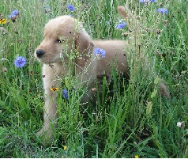


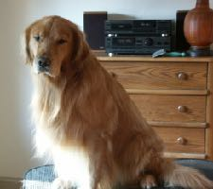
Becoming a physician-investigator at Penn
Years 1&2
Year 3
As long as it takes to be great
Preclinical
PC
Clinics
Your
thesis
grad
prelim.
grad
grad
lab
grad
lab
lab
clinical connections
TiMM
CSTR
defense
get a job
residency?
Med
3/4
graduation
postdoc?
big dog
About 16 mos

Slide 3
The bridge: 6⁺ years
residency?
get a job
Med
3/4
Other
stuff
graduation
postdoc?
For nearly all of you, more years of training and growing independence will be needed between when you graduate and when you have a job. The purpose of this presentation is to de-mystify those “bridge years.”

Slide 4
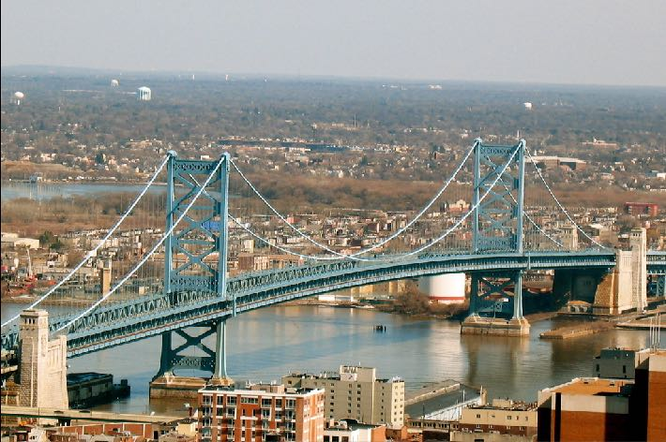
The bridge years
Residency
residency?
Postdoc
get a job
Med
3/4
Other
stuff
graduation
Job search
postdoc?

Slide 5
The bridge years: 5 steps to success
Planning for the future need not be scary. Start with a general destination in mind and let the details evolve. It is hard to arrive where you want to be without some idea of what it should look like when you get there. Without that, how will you know what to pack?

Slide 6
5 steps to success
The bridge years
#1 - Decide on your long term career goals*
#2 - Decide if your goals require more training
#3 - Decide which clinical field fits your goals & talents
#4 - Pick your residency/fellowship/postdoc carefully
#5 - Prepare yourself for the job search
*even if you don’t know the details, develop some general ideas

Slide 7
Decide on your career goals
The bridge years: Step #1
Physician? Scientist? Educator?
Be a triple threat? How much time to each?
Professional time Vs. everything else?
Academic center? Research institute? Industry?
Full time research?
Full time clinical practice? (I hope not!)

Slide 8
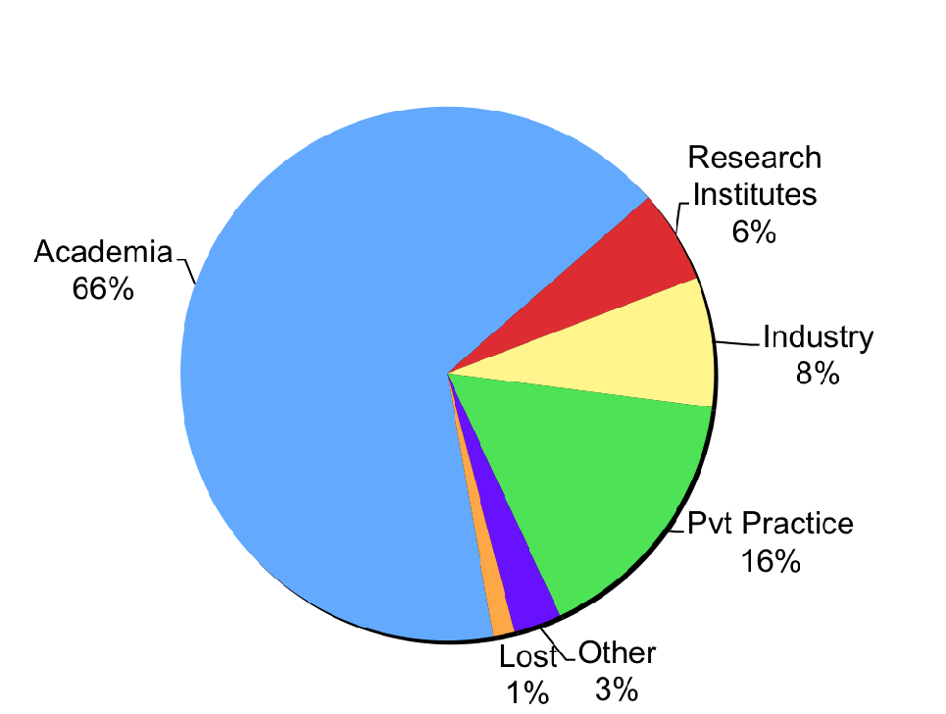
What are your predecessors doing?
Long term outcomes for MD-PhD program graduates
(2202 responses)
Academia
Research institutes
Industry
80%
Two-thirds of graduates end up in academia, but their job descriptions vary. Plan ahead if you want the options to be chosen by you and not by your department chair. Pick a field and a department based on your own goals.
2007-2008 survey
NAMP & AAMC/GREAT/CD section

Slide 9
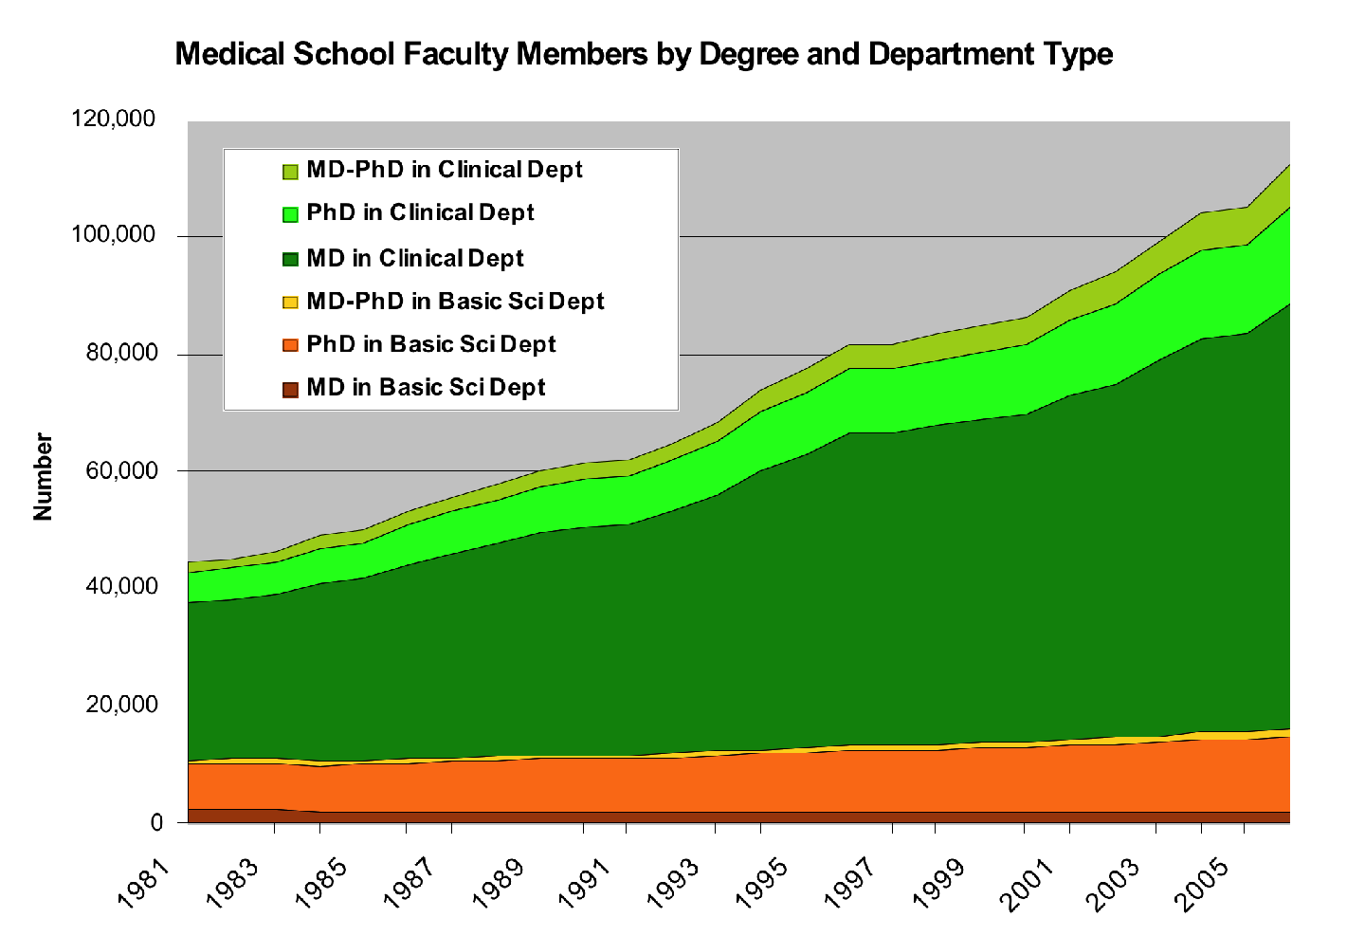

MD-PhD clinical dept
Most of the jobs for physicians are in clinical departments
MD-PhD basic science dept
MD’s in clinical dept
Source: http://www.aamc.org/data/facultyroster/reports.htm
Notes:
Medical School Faculty Appointments
Source:
Faculty Roster
Association of American Medical Colleges
http://www.aamc.org/data/facultyroster/reports.htm
Survey Characteristics
The AAMC collects comprehensive information on the characteristics of paid faculty members at accredited U.S. allopathic medical schools. When individuals are first appointed to faculty positions, medical schools submit educational, employment, and demographic data to the Faculty Roster, and updates are made as needed. Institutional participation in the Faculty Roster is voluntary.
Survey Dates: 1966-2006
Field Specifications:
Basic Sciences: Anatomy, Biochemistry, Microbiology, Pathology (Basic Science), Pharmacology, Physiology, Other Basic Sciences
Clinical Sciences: Anesthesiology, Dermatology, Emergency Medicine, Family Medicine, Internal Medicine, Neurology, Obstetrics & Gynecology, Ophthalmology, Orthopedic Surgery, Otolaryngology, Pathology (Clinical), Pediatrics, Physical Medicine & Rehabilitation, Psychiatry, Public Health & Preventive Medicine, Radiology, Surgery, Other Clinical Sciences,
Other: Dentistry, Other Health Professions, Social Sciences, Veterinary Sciences
Survey Notes:
Tabulations are made by Department, School, Academic Rank, Race/Ethnicity, Degree, Sex, Tenure Status
Contact Information:
Hershel Alexander, Ph.D.
Director, Faculty Data Systems and Studies
halexander@aamc.org

Slide 10
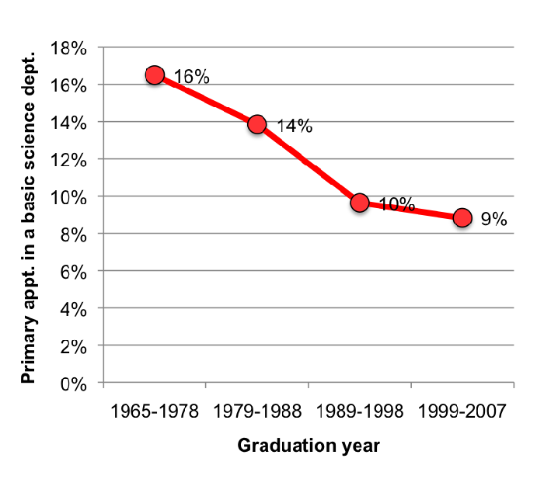
Fewer MD-PhD graduates have their primary appointment in a basic science department
Statistically, you are more likely to end up in a clinical department than a basic science department, but try to be the one who decides.

Slide 11
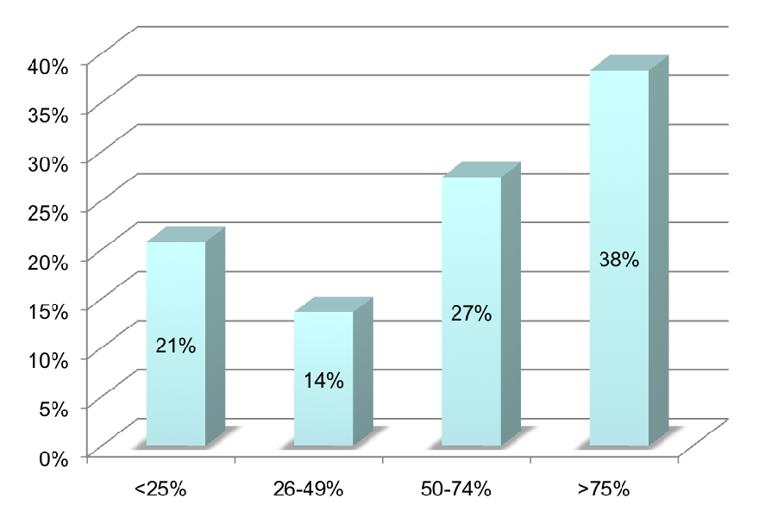
How much of your time is devoted to research?
(data from 698 alumni in academia who do research)
% of alumni responses
Time spent on research (%)
Research takes time - lots of it. If you plan to be a credible researcher, make sure you are as far as possible to the right on this curve. Choose where you work carefully so that someone else’s priorities don’t push you to the left.
2007-2008 survey
NAMP & AAMC/GREAT/CD section

Slide 12
Constantly chimeric
Being a physician-scientist doesn’t mean endlessly oscillating between being a physician and a scientist. Chimerism is what makes the perspective of the physician-scientist unique. You do not have to give up that goal, but you do have to be thoughtful about how best to achieve it.

Slide 13
Decide if your goals require more training*
The bridge years: Step #2
Residency (then postdoc) Vs. postdoc (no residency)
Will you continue to practice medicine?
Is your goal to be in a clinical department? (then you will probably need a license and a board certificate)
Clinical research? (then you will likely need training that was not included in an MD-PhD program)
*they probably will

Slide 14
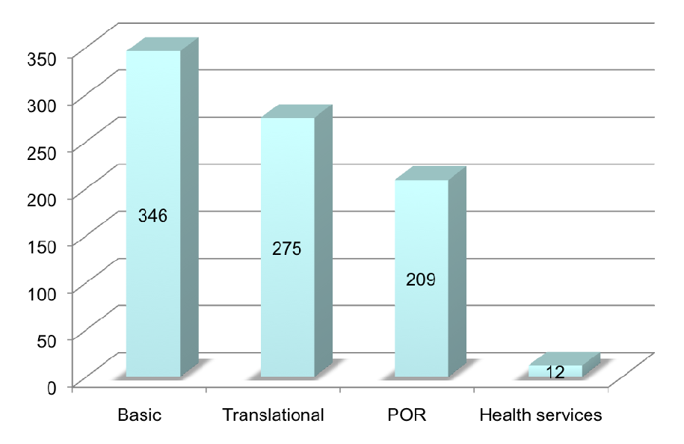
What kinds of research do you do?
(data from 592 alumni working in academia)
Note: multiple responses were allowed (and typical)
Lots of MD-PhD alumni report doing patient oriented research as part of their mix. This requires a stronger dose statistics and human studies training than most of us receive as MD-PhD trainees.
2007-2008 survey
NAMP & AAMC/GREAT/CD section

Slide 15
Decide which clinical field fits your goals & talents
The bridge years: Step #3
Choose something you will enjoy and find challenging, but also ask:
  Does the field value research or does it place a higher priority on clinical service?
  Will the field of your choice protect the time needed for meaningful research?
  Have you explored your choice from a faculty perspective and not just from the med student perspective (they are very different points of view)?
Clinical Connections is designed to help you make informed choices. Take advantage of it. Network.

Slide 16
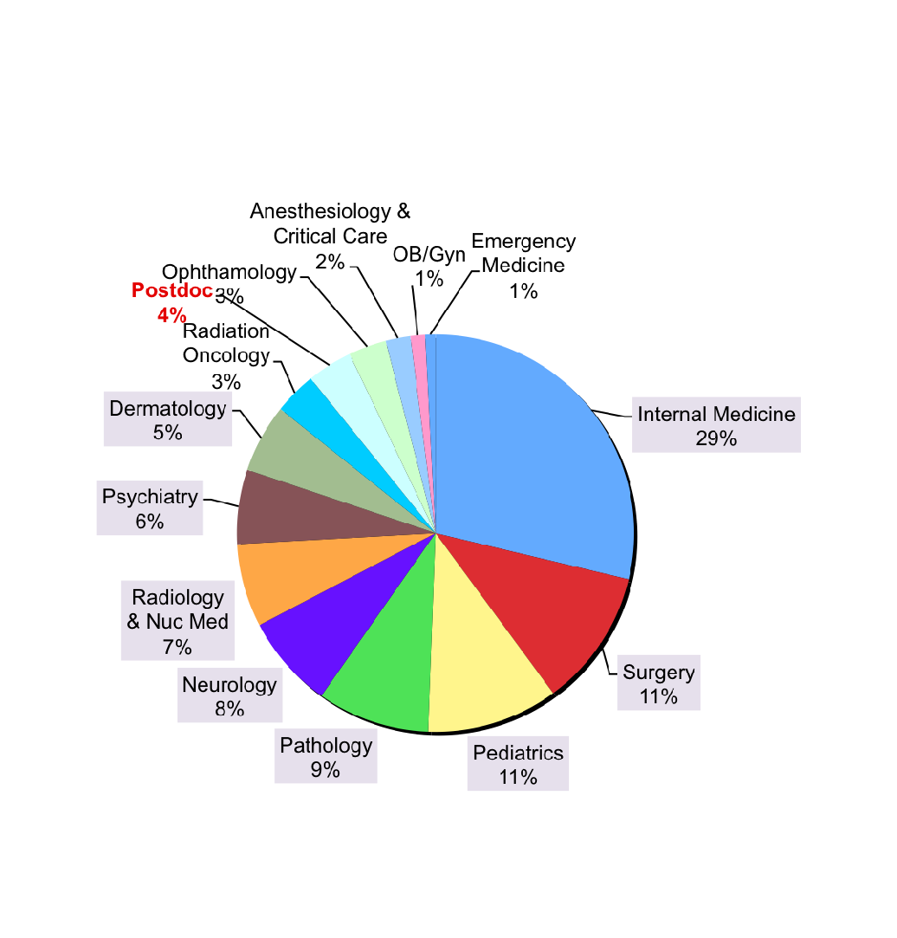
Short term outcomes: fields selected by graduates who are still in training
(842 respondents)
Internal Medicine
Pediatrics
Pathology
Neurology
57%
2007-2008 survey
NAMP & AAMC/GREAT/CD section
96% of recent graduates in this survey chose to do residencies. The range of choices is broad, but not all residencies lead to careers that are equally research friendly. Make sure your choice of a clinical field fits your long term goals. Everyone should consider whether doing a residency is necessary for their choice of career and fits with their personal interests and talents.

Slide 17
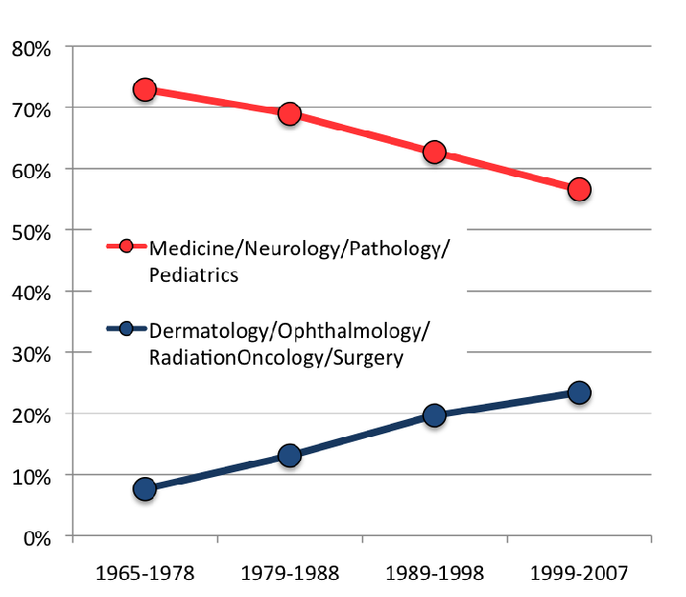
Trends in residency choice
Residency choice
Graduation year
Popular field choices change over time. Internal medicine seems to be increasingly popular over the past 2 years. Pick a field based on your interests and talents, not based on what those with different goals are selecting in any given year - especially if you are headed towards a research-focused career.

Slide 18

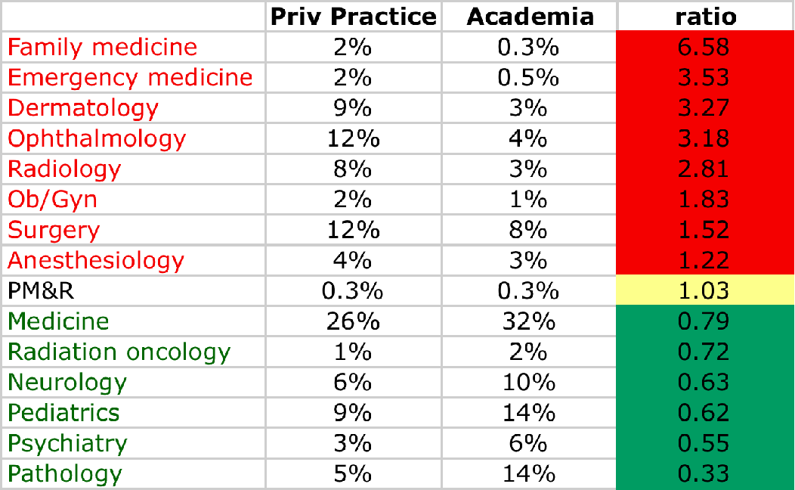
Residency choice as a predictor of outcome
alumni who have completed training
More likely to be in private practice
More likely to be in academia
N=364
N=1498
Historically some field choices predict a greater likelihood of ending up in private practice, but nothing is absolute. The choices are mostly yours to make. Choose according to your goals and interests.
© Brass, et al. for NAMP and AAMC/MD-PhD section

Slide 19
Lifestyle issues
Being a physician-scientist is not incompatible with having a life, a family and anything else that you value. All professions require that you set boundaries on your professional time. Decide for yourself where those boundaries should lie. change them when you need to and use the time spent within them as efficiently as possible.

Slide 20
Choose your residency/postdoc carefully
The bridge years: Step #4
If postdoc instead of residency, then go where the best science is. Ditto for fellowship after residency.
If residency, go where they value your goals.
  Do you want high quality, intensive clinical training? Many places will offer that. There are other factors to consider as well.
  Get back to research ASAP. When available, “short tracking” is an option worth considering - your subspecialty training, not your generalist training, is far more likely to be what you will be doing clinically.
  You don’t have to do a residency and fellowship at the same place. Pick fellowships with access to great investigators.
  Different clinical fields and different programs value research differently.

Slide 21
Choose your residency/postdoc carefully
The bridge years: Step #4 (cont’d)
Residency directors tend to be clinicians. They are looking for capable candidates who can thrive clinically as residents.
Popular programs often screen candidates using board scores and clerkship grades before they even consider factors like research experience & success.
To maximize your match outcome, do well clinically, especially in core rotations and the sub-internship.

Slide 22
Prepare for the job search
The bridge years: Step #5
Hiring new tenure track faculty is expensive and it will be awhile before you can cover your costs. The person who hires you will want to be as certain as possible that are likely to succeed.
  Success in the post-residency/postdoc years is used to predict subsequent success
  Demonstrate your skills along the way, by completing projects, publishing manuscripts and obtaining grant funding (e.g. K awards)
Find mentors. Make contacts with people who can attest to your qualities and/or collaborate with you in the future.
Most physician-scientists are in clinical departments.
There will be a job for you…

Slide 23
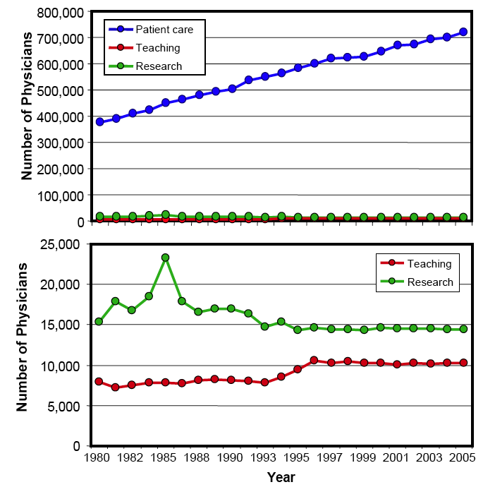
The number of physicians performing research and teaching has been essentially unchanged for years
Adapted from Tim Ley’s analysis of AMA data

Slide 24
If the average career length is 30 years, then 500 new physician-investigators are needed each year just to maintain steady state.
This is approximately the number of MD-PhD program graduates per year - not all of whom will choose to become physician-investigators.
There will be a job for you, but you need to make sure that the one you get is the one you want - and the one that best fits with your career goals.

Slide 25
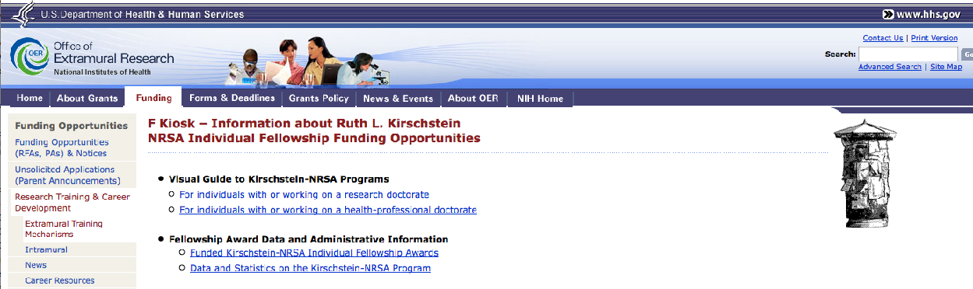
Look for opportunities to compete for grants during grad school
http://grants1.nih.gov/training/F_files_nrsa.htm
Your support thru the MD-PhD program doesn’t depend on your ability to obtain your own funding, but this is a great opportunity to practice skills you will need later. It also helps your thesis mentor and looks great on your cv and may give you access to funds for professional use.

Slide 26
SUCCESS RATE OF KIRSCHSTEIN-NRSA PRE-DOCTORAL
FELLOWSHIP (F31) APPLICATIONS
Reviewed
Awarded
Success Rate
F31 Predoc Fellowships
Funding rates on F31’s are still respectable.
Number of Applications/ Awards
35%
Success Rate
Fiscal Year

Slide 27
Look for non-NIH opportunities to compete for grants in grad school
American Association of University Women
American Cancer Society
American Chemical Society
American Diabetes Association
American Federation for Aging Research Scholarship
American Heart Association
American Physiological Society
American Society for Microbiology
American Society for Pharmacology and Experimental Therapeutics
Ford Foundation Dissertation Diversity Fellowships
Josephine de Karman Predoctoral Fellowship
L’Oreal Foundation Women in Science
NASA Individual Predoctoral Fellowship
Paul and Daisy Soros Fellowship for New Americans
Sarnoff Cardiovascular Research Foundation Fellowship
UNCF•Merck

Slide 28
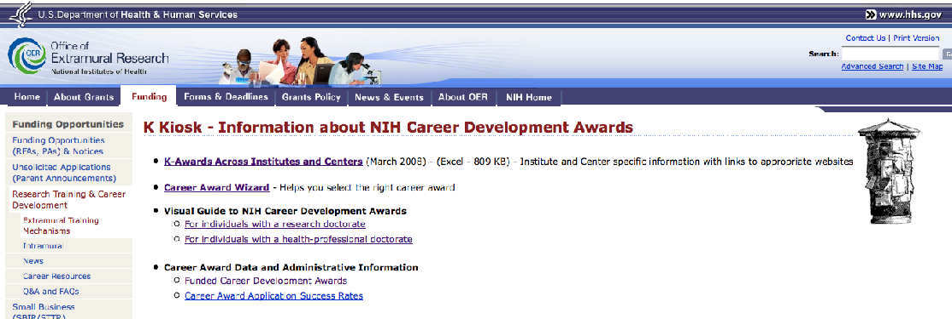
Definitely compete for grants as a postdoc/fellow
http://grants1.nih.gov/training/careerdevelopmentawards.htm
Obtaining individual funding as a postdoc/fellow should be a high priority. Not only is it good practice for the future, it shows those who will hire you that you have an important skill.

Slide 29
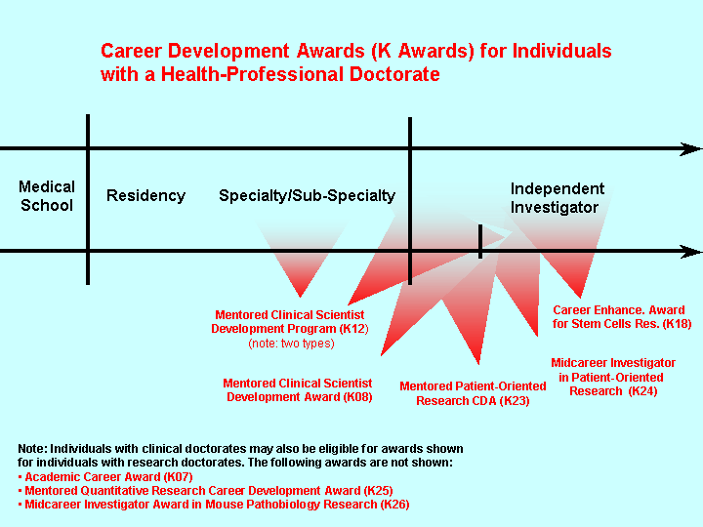
K12
K08
K99/R00

Slide 30
SUCCESS RATE OF KIRSCHSTEIN-NRSA POST-DOCTORAL
FELLOWSHIP (F32) APPLICATIONS
Reviewed
Awarded
Success Rate
F32 Postdoc Fellowships
25%
Number of Applications/ Awards
Success Rate
Fiscal Year

Slide 31
MD-PhDs receive
15% of K23
40% of K08
49% of R01
awarded to physicians
(2004 data from Ley and Rosenberg JAMA 294:1343, 2005)

Slide 32
5 steps to success
The bridge years
#1 - Decide on your long term career goals
#2 - Decide if your goals require more training
#3 - Decide which clinical field fits your goals & talents
#4 - Pick your residency/fellowship/postdoc carefully
#5 - Prepare yourself for the job search
Step #1 is a biggie. Do the best you can with it. Develop some general priorities as early as you can, then let them evolve as you move thru the MD-PhD program. Your choice of a residency field will have considerable long term impact, so make sure it is a well-informed choice.

Slide 33
final thoughts
All of you are smart and capable or you wouldn’t be here (trust me on that one)
You will have options. Prepare yourself to choose wisely among them.
Don’t be concerned if you are still uncertain, but do keep working on it.
Becoming a physician/investigator is what you told us you wanted when you arrived. It is still a wonderful choice.
All of us are here to help you reach your goals. Let us do that.

Slide 34
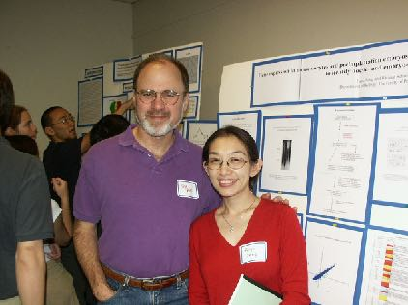
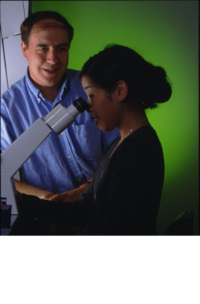
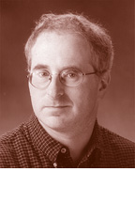
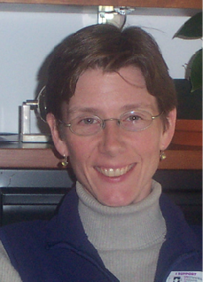
Planning for your future
University of Pennsylvania
Medical Scientist Training Program

Slide 35
“Planning for your future” series
Negotiating strategies
How to give a better lecture
Traversing the bridge years
Applying to residencies and fellowships
How do NIH study sections think?

Slide 36
24th Annual National MD/PhD Student Conference
July 24-26, 2009
Keystone, CO
5th Annual American Physician Scientists Association (APSA)
April 24-26, 2009
Chicago, IL
(joint with ASCI & AAP)

Slide 37
National MD-PhD Conference for
Scholars in the Humanities
March 28-29, 2009
University of Pennsylvania
(Erica Dwyer & Elise Carpenter)

