Slide 1
SCTR LAB SERVICES BILLING Application Update
Alketa Ndoka , Associate Director, SPO Business Operations
in partnership with
PMACS Team Alpha

Slide 2
SCTR LAB SERVICES BILLING
Intro 1
Goes live – November 1, 2024
Still accessible through: https://www.med.upenn.edu
Allocates CO₂ & glasswash charges to accounts
Posts charges on the 15th of each month
October 28, 2024
Questions to SPO-Finance@pennmedicine.upenn.edu
2
October 28, 2024
2
Notes:
The new application is still accessed through med.upenn.edu/SCTR Lab Services Billing.
It is used to allocate CO₂/glasswash charges to PIs that use the commodity and service in SCTR and SPE.
Charges will still post through a feeder on the 15th calendar day of each month

Slide 3
SCTR LAB SERVICES BILLING
Intro 2
NEW!!
Notifications for expiring accounts
Detailed invoices for glasswash & CO₂
Ability to see past invoices
October 28, 2024
Questions to SPO-Finance@pennmedicine.upenn.edu
3
October 28, 2024
3
Notes:
With the new application:
Now, you will get notifications for accounts expiring in the next 30 days
You will be emailed detailed invoices when charges post to CAMS, and
You will have the ability to see & download current and past invoices in the application

Slide 4
SCTR LAB SERVICES BILLING
Intro 3
for example:
Notification 30 days prior to expiration
Automatic email to Business Administrators
Automated in new system
From: PMACS Team <donotreply@pennmedicine.upenn.edu>
Sent: Thursday, July 25, 2024 9:30 AM
To: angie.craig@emailaddress.edu
Subject: SCTR Lab Services Billing - PI Account Expirations
Angela Craig,
There are 2 PIs in SCTR Lab Services Billing who are associate with you and have expired/expiring accounts in use for billing.
They are listed below.
Manage PI Accounts in SCTR Lab Services Billing
John G Adams
Expired accounts:
1234-123456-1234
Jane L Doe
Expired accounts:
1234-123456-1234
____________________________________________
SCTR Lab Services Billing
SPO-Finance@pennmedicine.upenn.edu
(215) 898-2876
Alketa Ndoka, Associate Director, Business Operations
Click this link in the email to manage your PI Accounts
Please take action! Here you see your list of expired accounts under a specific PI
October 28, 2024
Questions to SPO-Finance@pennmedicine.upenn.edu
4
October 28, 2024
4
Notes:
This is an example of the email the system will automatically send if you have PIs whose accounts are expiring in the next 30 days.
Please take action to change these allocations.
You can do this by clicking on the “Manage PI accounts”, or by navigating to med.upenn.edu

Slide 5
SCTR LAB SERVICES BILLING
Account Mod 1
1
Navigate to: https://www.med.upenn.edu
Click on SCTR Lab Service Billing
It will open up the list of PIs that
you manage…
2
3
October 28, 2024
Questions to SPO-Finance@pennmedicine.upenn.edu
5
Notes:
… and clicking on SCTR Lab Services Billing . This will open up the list of PI Listing for you, with all the PIs that you manage

Slide 6
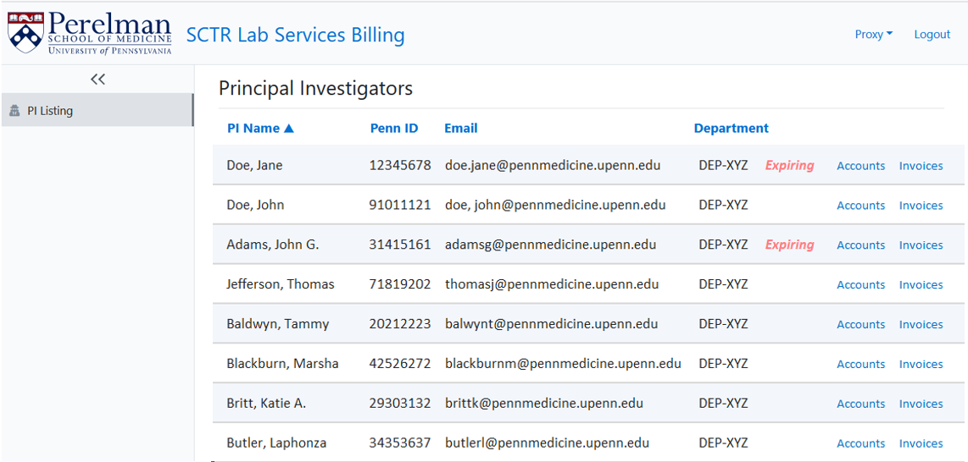
SCTR LAB SERVICES BILLING
Account Mod 2
for example:
PI’s rolling up to a BA appear on the PI Listing
Select the PI you want to update by clicking on “Accounts”
October 28, 2024
Questions to SPO-Finance@pennmedicine.upenn.edu
6
October 28, 2024
6
Notes:
Notice on the right side of the screen, it alerts you for PIs with expiring accounts, as well as gives you the option to go to the accounts screen, or invoice screen for each PI.
Let’s say you want to act on the notification you just received, and want to change the allocations for John Adams.
You can do that by clicking on Accounts for Adams, this will open the screen with the account allocations for him

Slide 7
SCTR LAB SERVICES BILLING
Account Mod 3
To remove expired account
1
Click on “Remove” to select the account you want to remove
John G. Adams
XYZ
2
Click on “Confirm” to remove
1234-123456-5678
October 28, 2024
Questions to SPO-Finance@pennmedicine.upenn.edu
7
Notes:
Notice the caution sign, next to Exp Date, that shows that the account is expiring soon, and that you will need to remove it from the allocations
Please remove the account by clicking on “Remove” ….and on “confirm” to complete the action

Slide 8
SCTR LAB SERVICES BILLING
Account Mod 4
To add new account
1
Click on “Add Account” to see the list of your available codes (Org, Fund, Cref)
John G. Adams
XYZ
2
Add 4060-014001-0911
Add 4006-123456-0911
Add 4082-123456-0911
Use the mouse to hover the gray bar over the account you’d like to add
October 28, 2024
Questions to SPO-Finance@pennmedicine.upenn.edu
8
Notes:
To add a new account, otherwise charges will post in suspense.
You can do that by clicking on the plus sign that says Add Account, this will give you the list of available accounts that you can chose from.
These are active accounts in CAMS that have SCTR Lab Services selected as one of the cores
Here you highlight and click on the account that you’d like to select

Slide 9
SCTR LAB SERVICES BILLING
Account Mod 5
To modify allocation
1
John G. Adams
To change the percentage:
Use the up/down toggle or
Click and type
XYZ
2
Click on “Update Glasswash”
October 28, 2024
Questions to SPO-Finance@pennmedicine.upenn.edu
9
Notes:
This will add the account you selected, so now you can assign a percentage for the allocation.
To do that you can either use the up/down toggle, or click on the field and type a percentage.
Remember to complete the process by clicking on “Update Glasswash”

Slide 10
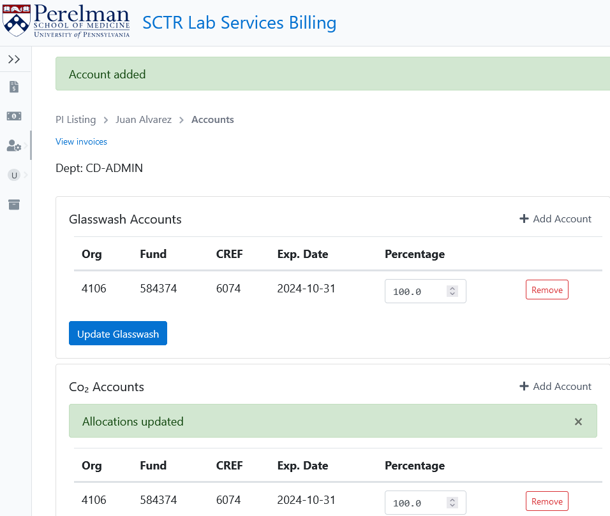
SCTR LAB SERVICES BILLING
Account Mod 6
Notice account changes are confirmed
Same process for CO₂
John G. Adams
XYZ
October 28, 2024
Questions to SPO-Finance@pennmedicine.upenn.edu
10
October 28, 2024
10
Notes:
Once you complete this process successfully, you will get a confirmation that the account was added.
If you want to add another account follow the same process, make sure that the sum adds up to 100.
Follow the same process to update CO₂ charges.

Slide 11
SCTR LAB SERVICES BILLING
Invoice Review 1
You can view invoices here, and also ...
John G. Adams
XYZ
John G. Adams
John G. Adams
XYZ
October 28, 2024
Questions to SPO-Finance@pennmedicine.upenn.edu
11
October 28, 2024
11
Notes:
As a note, also from this screen, you can view invoices for a PI, by clicking on “View Invoices.” on the top left side
You can quickly transition from the accounts to the invoice screen and vice versa
You can also get to the invoice screen by going to PI listings

Slide 12
SCTR LAB SERVICES BILLING
Invoice Review 2
… here
for example:
PI’s rolling up to a BA appear on the PI Listing
Select the PI invoice you want to review by clicking on “Invoices”
October 28, 2024
Questions to SPO-Finance@pennmedicine.upenn.edu
12
October 28, 2024
12
Notes:
by clicking on “Invoices”

Slide 13
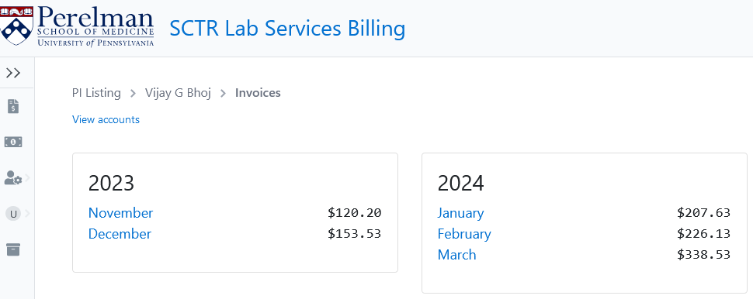
SCTR LAB SERVICES BILLING
Invoice Review 3
View all billing for a specific PI
Click on the month to view detailed invoices for CO₂ & glasswash
You can also download the invoice
John G Adams
October 28, 2024
Questions to SPO-Finance@pennmedicine.upenn.edu
13
Notes:
This will bring up the invoice screen for the PI you have the ability to go back to accounts, by clicking on “view accounts”

Slide 14
SCTR LAB SERVICES BILLING
Invoice Review 4
View all billing for a specific PI
Click on the month to view detailed invoices for CO₂ & glasswash
You can also download the invoice
John G Adams
View detailed invoice for a specific month
October 28, 2024
Questions to SPO-Finance@pennmedicine.upenn.edu
14
Notes:
This is the invoice screen. It shows you all the invoices posted for a PI.
The invoice amount combines CO₂ and Glasswash.
You can drill down to the monthly charges, by clicking on the month you want to review.
Let’s say we want to review the invoices for March.
Click on March to open that particular invoice.

Slide 15
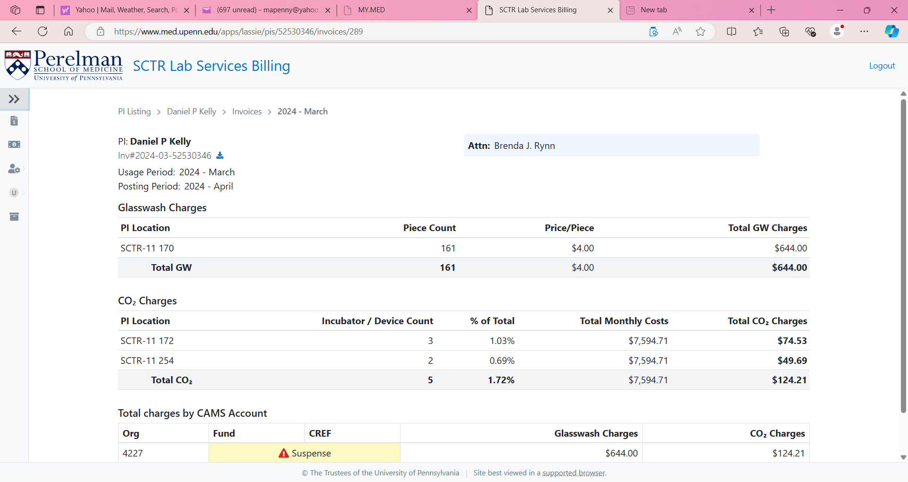
SCTR LAB SERVICES BILLING
Invoice Review 5
Franklin Pierce
Franklin Pierce
Attn: Summer L. Lee .
October 28, 2024
Questions to SPO-Finance@pennmedicine.upenn.edu
15
Notes:
Here is an example of the invoice that opens up in the application.
So, let’s take a closer look at it.

Slide 16
SCTR LAB SERVICES BILLING
Invoice Review 6
BAs can review & download invoices
Invoices will be emailed monthly on the 15th
Franklin Pierce
Franklin Pierce
Attn: Summer L. Lee .
Franklin Pierce
Franklin Pierce
Download to PDF
October 28, 2024
Questions to SPO-Finance@pennmedicine.upenn.edu
16
Notes:
First, I would like you to notice the download button under the PI name, by clicking on it you can download invoices in PDF, so you can save them somewhere locally for your records

Slide 17
SCTR LAB SERVICES BILLING
Invoice Review 7
DO NOT PAY – this invoice is for your records. Payment will be electronically journaled
You can access the same information three ways:
On the invoice review screen
On the downloaded file
On the .pdf attachment to the monthly email on the 15th
Franklin Pierce
Attn: Summer L. Lee .
Please direct questions to:
SPO-Finance@pennmedicine.upenn.edu
Space Planning & Operations
Perelman School of Medicine
University of Pennsylvania
Tel: 215-573-8854
October 28, 2024
Questions to SPO-Finance@pennmedicine.upenn.edu
17
Notes:
Here is a sample of a PDF invoice. Remember there are three ways to access this information…
on the invoice screen,
on the downloaded file,
and from the monthly email that is sent out when charges post to CAMS

Slide 18
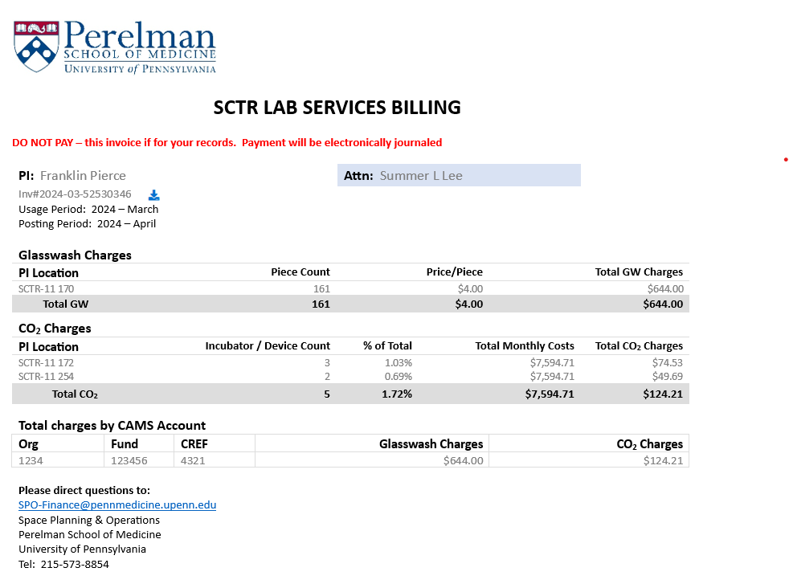
SCTR LAB SERVICES BILLING
Invoice Review 8
Top of Invoice: Recipient Information
Invoice is directed to the BA’s attention
PI,
usage, and
posting information
October 28, 2024
Questions to SPO-Finance@pennmedicine.upenn.edu
18
Notes:
Let’s take a quick look at an invoice.
The top section of the invoice clearly states the PI name, usage period and posting period, and the invoice number ties back to the journals posted in BEN
Invoices are directed to the BAs attention only, and PIs do not get a copy of these invoices.

Slide 19
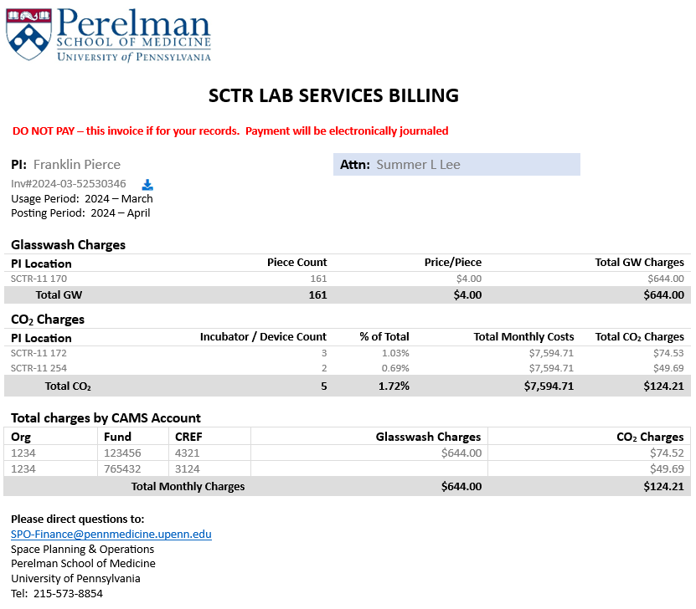
SCTR LAB SERVICES BILLING
Invoice Review 9
Monthly Usage & Charge Calculations
2
3
1
4
5
1
Separate sections for glasswash and CO₂
2. Glasswash piece count at each location per month
3. Journal line-item amount and subtotal for glasswash
CO₂ device count at each location and prorated SCTR total CO₂ cost
5. Journal line-item amount and subtotal for CO₂
October 28, 2024
Questions to SPO-Finance@pennmedicine.upenn.edu
19
Notes:
Moving down to the next session..
The invoice has a separate section for Glasswash and for CO₂,
For Glasswash it shows monthly piece count for each location, price per piece
….and the subtotal for glasswash that should match with the charges that will post in BEN
For CO₂ it shows the device count at each location, prorated total cost
….and the subtotal for CO₂ cost that should also match with CO₂ charges in BEN

Slide 20
SCTR LAB SERVICES BILLING
Invoice Review 10
Account Allocations
Based on allocations you provide
In case of expired accounts, charges post to Suspense, and the invoice provides notification
October 28, 2024
Questions to SPO-Finance@pennmedicine.upenn.edu
20
Notes:
There is also a section that breaks down the charges, based on the allocations that you have selected earlier.
In case of expired accounts charges will go to suspense, you will have to move them out of suspense, and go into the account screen, and correct the allocations for next month.

Slide 21
SCTR LAB SERVICES BILLING
Invoice Review 11
Bottom of Invoice: Where to get help
Please direct questions to:
SPO-Finance@pennmedicine.upenn.edu
Space Planning & Operations
Perelman School of Medicine
University of Pennsylvania
Tel: 215-573-8854
October 28, 2024
Questions to SPO-Finance@pennmedicine.upenn.edu
21
Notes:
The final section provides contact information. Please direct all questions to SPO-Finance@pennmedicine.upenn.edu, and we will make sure to respond within a business day

Slide 22
SCTR LAB SERVICES BILLING
Questions?
October 28, 2024
Questions to SPO-Finance@pennmedicine.upenn.edu
22

Slide 23
Notes:
Thank you!

