Slide 1
PCMD Biomechanics Core – Learning Lunch
2/15/19

Slide 2
Biomechanics?
What is the function of…. musculoskeletal tissues (bone, cartilage, tendon, etc)?

Slide 3
Biomechanics and the MS
To understand normal tissue and joint structure and function
  motion, loads, joint function, locomotion, gait
To understand, diagnose, and treat pathology
  Joint instability, fracture healing, arthritis, osteoporosis, injury
Design and develop implants and devices
  Total joint replacement
  Fracture fixation plates and screws
  Biological treatments

Slide 4
Fundamental Mechanics Terms/Ideas
Force
Moment
Stress
Strain
Material Properties
Structural Properties
Static Equilibrium
Dynamics
Tension
Compression
Shear
Bending
Torsion
Friction
Wear
Viscoelasticity
Anisotropy
Fatigue

Slide 5
Stress
Intensity of force (σ)
Force / Area
  1 Pa = N/m²
  1 MPa = N/mm²
Specific to a point and a direction in a structure
Takes into account geometry!
F
F
>

Slide 6
Force vs. Stress
Example: Bar in compression
F
F
Cross-sectional
Area: A
Stress = Force / Area = F/A
units = psi, pascals, MPa

Slide 7
What Does Force (or Stress) do?
When force is applied to a deformable body it undergoes deformation
Extent of deformation is defined by the properties of that material
The relationship between force (F) and deformation (δ) is called the stiffness (S)
Undeformed
F = S * δ
F
S
F
Deformed
δ

Slide 8
Strain (ε) =
Displacement vs. Strain
10 cm
20 cm
2 cm
2 cm
What happens if we deform two objects by the same amount, but they start with different lengths?
Change in Length (δ)
Original Length (L_{O})
(As with stress, with strain we take geometry into consideration)

Slide 9
Force-Displacement vs. Stress-Strain
C
B
A
Same material, but different apparent stiffnesses
(Structural Properties)
A
F
Force
B
F = S * δ
F
Displacement
Normalization allows for comparison of samples of different shapes and sizes – Slope is called the modulus (E)
(Material Property)
A, B, & C
C
Stress
E_{Y}
F
σ = E * ε
Strain

Slide 10
Elements of a Stress-Strain Curve

Slide 11
Material Characteristics
Elastic - Stress is directly proportional to strain and deformation is fully recovered when a load is removed.
Brittle - exhibits a linear stress–strain curve to failure and elastic deformation only (e.g., polymethylmethacrylate, PMMA).
Ductile – materials such as metals undergo a large amount of plastic deformation before reaching failure.
Stress
Strain

Slide 12
Material Properties
Moduli can be determined in a number of different loading configurations:
  Tension
  Compression
  Shear
  Combinations of the above
Moduli can vary with:
  Deformation state (non-linearity)
  Time (viscoelasticity)
  Direction (tension-compression nonlinearity)
  Direction (anisotropy)

Slide 13
Linear vs. Non-Linear
Linear Materials
  Modulus is same with any level of deformation
Non-Linear Materials
  Intrinsic to material
  Strain-hardening
  Structurally based (as with tendons/ligaments)
Linear
Stress
Non-Linear
Strain

Slide 14
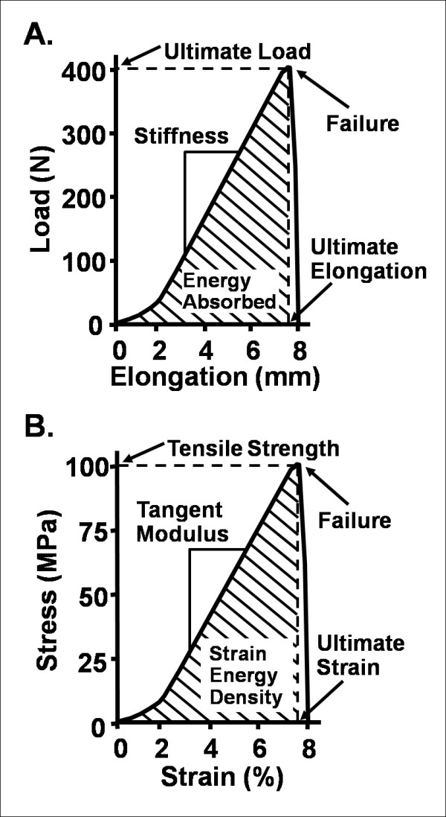
Nonlinearity
Phenomenological solution:
σ = A[exp(Bε)-1]

Slide 15
Elastic and Viscoelastic Materials
Increasing Strain Rate
Elastic - Stress is directly proportional to strain and deformation is fully recovered when a load is removed. Elastic materials are insensitive to the rate of loading.
Viscoelastic – stress-strain behavior depends on time and rate of loading. Viscoelasticity is a function of internal friction in the material.
Stress
Strain

Slide 16
Creep and Stress Relaxation
Viscoelasticity (time-dependant behavior) is characteristic of most biologic tissues
  Creep: a constant load is applied and deformation increases with time
  Stress Relaxation: a ramped deformation is held, load increases and then relaxes to equilibrium
Mechanisms
  Friction between matrix molecules
  Drag due to fluid flow and pressurization
  Constitutes energy loss / dissipation
Force
creep
recovery
Displacement
time

Slide 17
Creep and Stress Relaxation
Viscoelasticity (time-dependant behavior) is characteristic of most biologic tissues
  Creep: a constant load is applied and deformation increases with time
  Stress Relaxation: a ramped deformation is held, load increases and then relaxes to equilibrium
Mechanisms
  Friction between matrix molecules
  Drag due to fluid flow and pressurization
  Constitutes energy loss / dissipation
Displacement
Stress
Relaxation
Force
time

Slide 18
Creep and Stress Relaxation
Viscoelasticity (time-dependant behavior) is characteristic of most biologic tissues
  Creep: a constant load is applied and deformation increases with time
  Stress Relaxation: a ramped deformation is held, load increases and then relaxes to equilibrium
Mechanisms
  Friction between matrix molecules
  Drag due to fluid flow and pressurization
  Constitutes energy loss / dissipation
Displacement & Force
Time
Stress
Strain

Slide 19
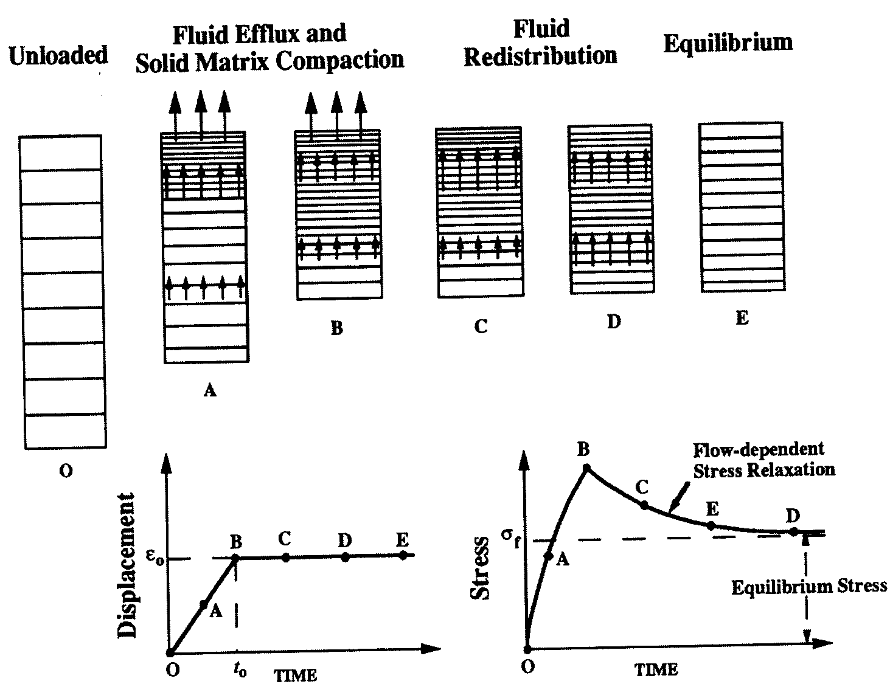
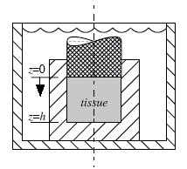
Confined Compression Stress-Relaxation
Permeable Indenter
Impermeable Wall
Relaxation time dependent on:
Sample Geometry (thickness or radius)
Sample Stiffness
(H_{A} or E_{Y})
Hydraulic Permeabilty
(k_{o})
0-A-B – Compression (Stress Phase)
B-E – Hold (Relaxation Phase)

Slide 20
Fluid Pressurization in Articular Cartilage
Peak Stress
Diarthrodial Joints
Total Stress
Fluid Pressure
W
Stress (Pa)
W
W
W
Fluid Pressure
Time
Time
W
•
W
•
60-85% Water Content
•
•
Low Permeability (k~10⁻¹⁵ m⁴/Ns)
•
1MPa (~150psi) =17.5 microns/sec fluid flow
•
Load Support (>90%)
Soltz and Ateshian, 1998, 2000

Slide 21
Dynamic Loading of Cartilage
1 hz
10 hz
0.1 hz
Faster compressive loading results in a higher dynamic modulus
40 hz
Stress (MPa)
0.01 hz
Compressive Strain

Slide 22
Isotropy vs. Anisotropy
Isotropic materials have the same mechanical properties in all directions.
Anisotropic material properties vary with the direction of applied load (biologic tissues are mostly anisotropic).
1
1
2
2
E₁
E_{1&2}
Stress
Stress
E₂
Strain
Strain

Slide 23
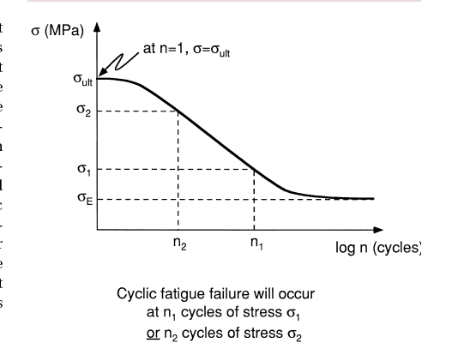
Fatigue
When subjected to a large number of cycles, materials will fail at a stress lower than the ultimate tensile stress
S-n curve
Endurance
limit

